Slide 1
Background: Why is a product and site selection process necessary?
Due to the decentralization of PMTCT services, mother-infant pairs are distributed across many facilities. However, the majority of them are concentrated in a smaller number of facilities
80% of patients at 26% of sites
10% of sites account for 59% of patients
5% of sites = 47% of patients
1% of sites = 24% of patients
80% of patients at 36% of sites
10% of sites account for 47% of patients
(5% of sites = 33% of patients
1% of sites = 13% of patients)
In order to to maximize access and patient impact, there is need to:
Select the sites that have the optimal patient volume as well as the capacity to implement POC EID testing effectively, complementing the existing laboratory network
Deploy the most appropriate products, given the needs, capacity, and limitations of specific sites
Notes:
Through the decentralization of PMTCT and scale-up of conventional EID, the number of sites offering PMTCT services and collecting EID samples is very high. However, the majority of HIV-exposed infants are concentrated at a small number of facilities. By providing POC EID at these high-volume sites, and large proportion of the HEI population can have access to POC EID without the need to deploy devices to a lot of facilities.

Slide 2
Product and site selection should be an iterative process involving key stakeholders
Lab network mapping
Preliminary product/site selection
Convene TWG / stakeholder consultation
Site assessment
Consultation
Final product/site selection
Implementation

Slide 3
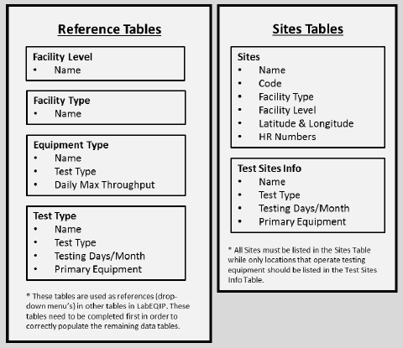
Laboratory network mapping is a necessary foundation for any optimization, including appropriate site and product selection
Map relevant health facilities and laboratories
Identify the location and type of equipment
Collect the GIS coordinates for health facilities
Collect other information such as electricity
Compile site-level testing demand

Slide 4
POC Product and Site Selection Tool
Clinton Health Access Initiative’s (CHAI) EID and VL Product and Site Selection Tool is an excel-based decision-making tool designed to help countries with:
Determining the optimal deployment of POC devices and conventional equipment to maximize patient impact while maintaining cost efficiency
Selecting the most appropriate POC EID and VL products for sites selected for POC testing
It is intended to help technical working groups (TWGS) and stakeholders better understand the current gaps in testing coverage in the country; identify the key country-specific criteria for selecting sites and POC products; and score those criteria to determine the balance between patient volume, access, and price when making decisions about site and product selection. It has been implemented in Cameroon, Malawi and Zimbabwe.

Slide 5
EID and VL Site and Product Selection Tool Overview (1 of 5)
Goal: Help countries determine optimal deployment of POC and conventional equipment at a site level to maximize patient impact while maintaining cost efficiency
1
Define country and site-level information
Enter details regarding country guidelines, existing equipment, lab operations, sample transportation, costs, and site-level patient data, including but not limited to:
ART patients
PMTCT patients OR historical EID test numbers
Existing access to testing (EID or VL)
Distance from lab or turnaround time in days
Presence of pediatric or nutrition ward
2
Assign site selection criteria
Weight most important criteria for site selection, including minimizing cost, improving on-site access to testing, or maximizing patient coverage
Choose maximum number of devices to be deployed per site

Slide 6
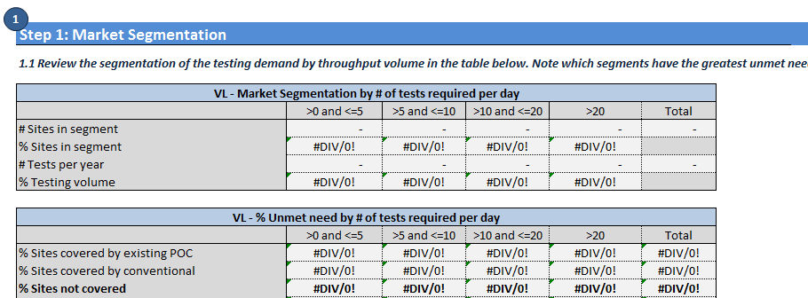
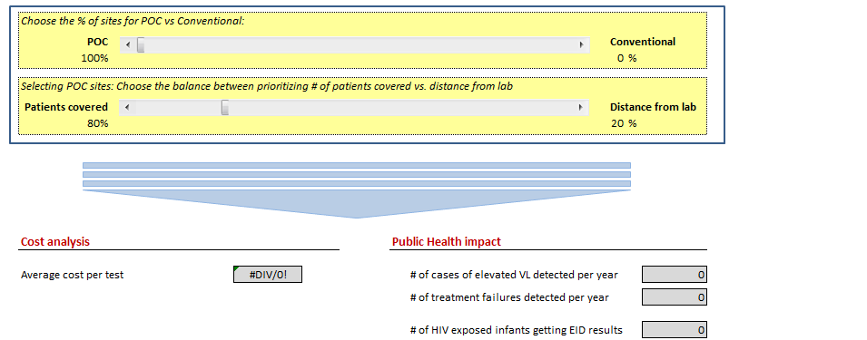
EID and VL Site and Product Selection Tool Overview (2 of 5)
3
Assess existing coverage through conventional systems and role of POC
Outputs of site-level data used to define access to on-site testing
User can test various scenarios shifting balance from conventional to POC at national level to determine potential patient and cost impact
This will help inform the overall balance between POC and conventional testing in country

Slide 7
EID and VL Site and Product Selection Tool Overview (3 of 5)
4
Determine key criteria for new product selection
Identify all the factors that should be considered when selecting new product
Identify percentage weights to be given to each criteria
Performance Criteria | >0 and <=5 | >5 and <=10 | >10 and <=20 | >20
Tests Offered (EID or VL) |  |  | 5% | 10%
Quantitative/Semi-Quantitative |  |  |  | 5%
Device/Device-Free | 5% | 5%
Throughput |  |  | 15% | 25%
Power Source | 20% | 20% | 10% | 10%
Connectivity | 10% | 10% | 20% | 15%
Device Cost | 20% | 20% | 10% | 5%
Reagent Cost | 10% | 10% | 10% | 10%
Ease of Use | 15% | 15% | 15% | 5%
After-Sale Support | 20% | 20% | 15% | 15%
5
Review product pipeline and assign scores to products
6
Select new products to deploy

Slide 8
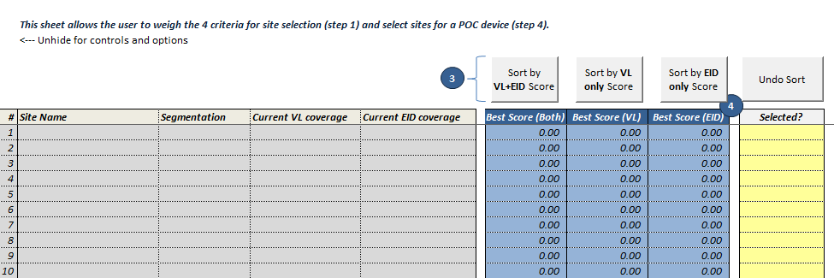
EID and VL Site and Product Selection Tool Overview (4 of 5)
7
Score and select sites and assign products
Sort sites to rank from highest to lowest based on EID, VL, or both
Select which sites will be chosen for new product deployment
Designate product for all chosen sites

Slide 9
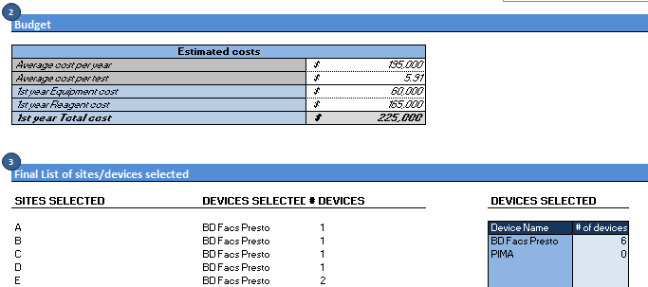
EID and VL Site and Product Selection Tool Overview (5 of 5)
8
Review outputs and adjust as necessary
Review model outputs, including:
Distribution of on-site access to testing by facility size
List of sites and devices selected
Required budget
Average cost per test
Public health impact
Adjust model outputs based on findings

Slide 10
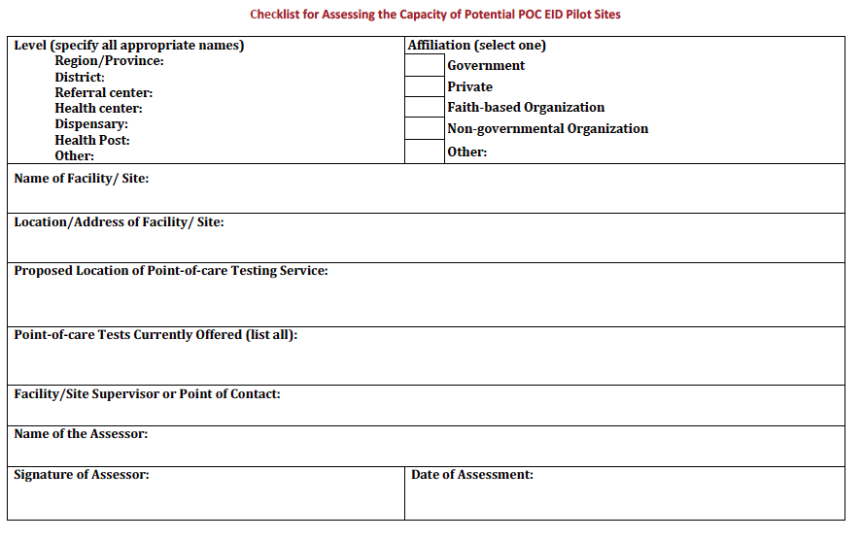
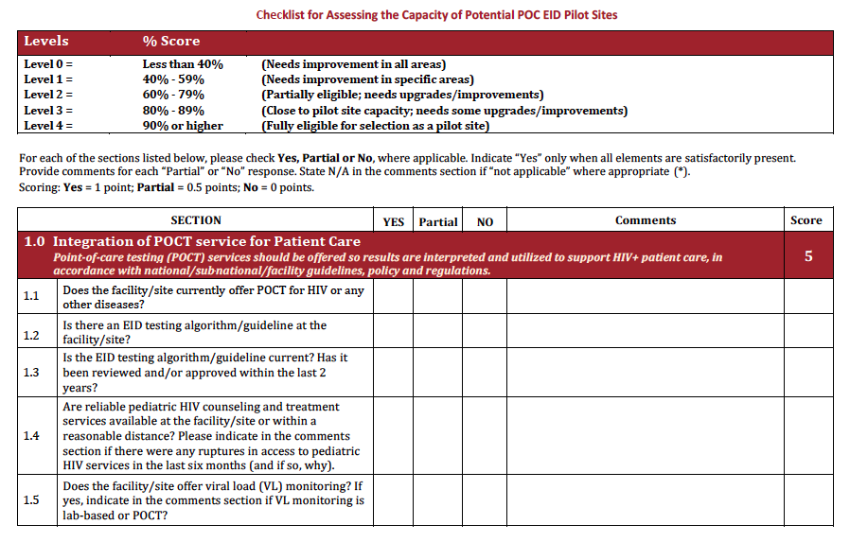
Site capacity assessments
This tool developed by EGPAF uses an adapted version of the CDC SPI Point-of-Care Checklist (CDC SPI SPOCT Checklist) to assess the capacity of a site to implement POC EID. Also helps to identify what site upgrades are needed, if any.
Analyzes the ability of each site to:
Integrate point-of-care testing into patient care
Identify and train appropriate staff
Provide the physical facilities required for POC EID testing, such as adequate space and electricity
Ensure the safety of health workers and patients
Implement POC EID tests
Ensure a reliable supply of quality POC EID supplies, reagents and equipment
Monitor the quality of testing

